Slide 1
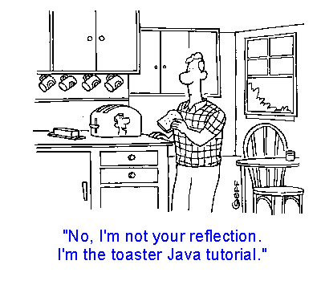
Software for speech recognition
Aldebaro Klautau - UCSD - ECE - SPIT
May 10, 2001

Slide 2
Outline
➔ Why speech recognition is a difficult task
➔ State of the art for digits recognition
➔ Example of using Spock
➔ Some details of front end and HMM algorithms
➔ More about Spock
➔ Sub-word models
➔ HTK
➔ Conclusions

Slide 4
Why is speech recognition difficult?
Theory:
from book “Visible Speech”
Practice:
coarticulation, target undershoot, etc.

Slide 5
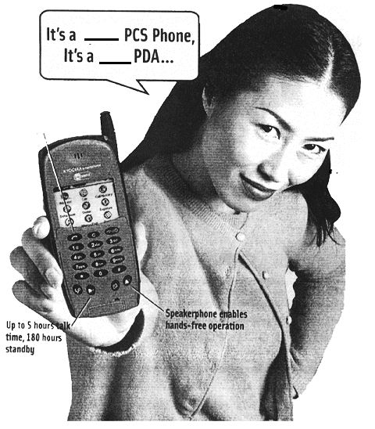
Voice activated dialing
State-of-art system for continuous digits
Big market!

Slide 6
Automatic speech recognition (ASR) overview
speech
Front end
features
Pattern recognition
words
Front ends:
Mel-frequency cepstral coef. (MFCC)
Perceptual linear prediction (PLP)
Relative Spectrum (RASTA)
Pattern recognition:
Hidden Markov model (HMM)
Dynamic time warping (DTW)
Artificial neural network (ANN)

Slide 7
Software publicly available

Slide 8
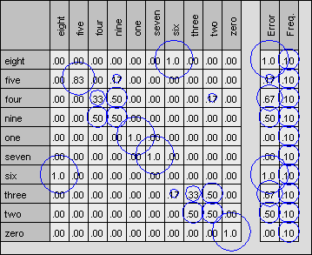
Spock - basics
Design and test an ASR system
Small database with 6 repetitions of 10 digits

Slide 9
Algorithm details
➔ Front end
MFCC
PLP / RASTA
LSF
➔ HMM training
Segmental K-means
Baum-Welch
Embedded Baum-Welch

Slide 10
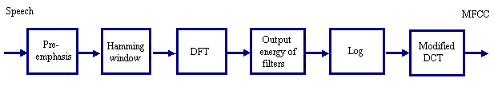
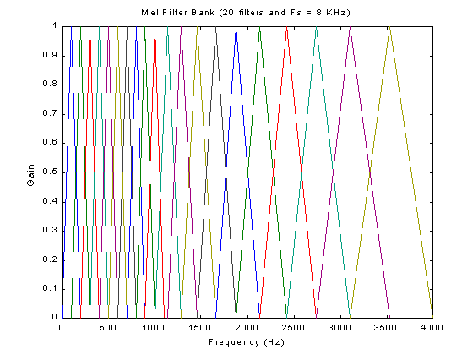
MFCC
H(z) = 1 - 0.97 z⁻¹

Slide 11
Spectra: MFCC compared to LPC and DFT-cepstrum

Slide 12
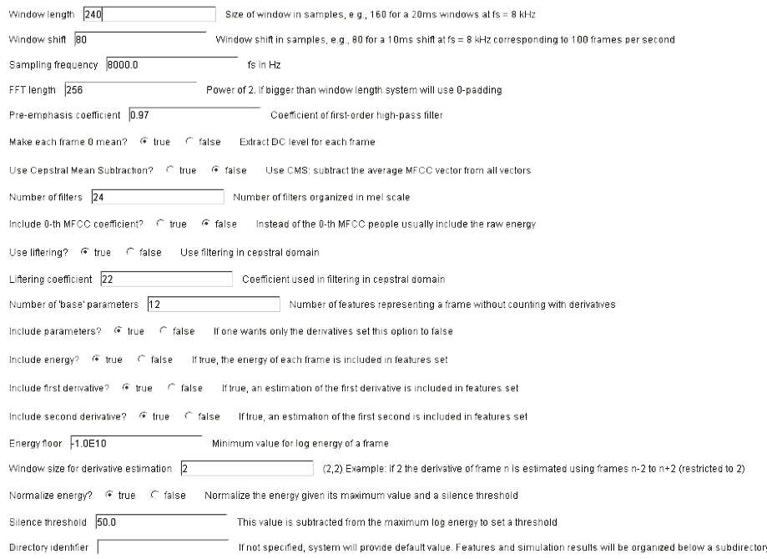

Slide 13
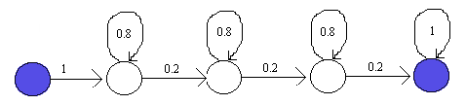
HMM
Left-right without skips HMM topology with an example of transition probabilities.
Left-right without skips HMM topology with non-emitting entry and exit states.
Finding the topology automatically [J. Hamaker, A. Ganapathiraju and J. Picone, "Information Theoretic Approaches to Model Selection," Proceedings of the International Conference on Spoken Language Processing, vol. 7, pp. 2931-2934, Sydney, Australia, November 1998].

Slide 14
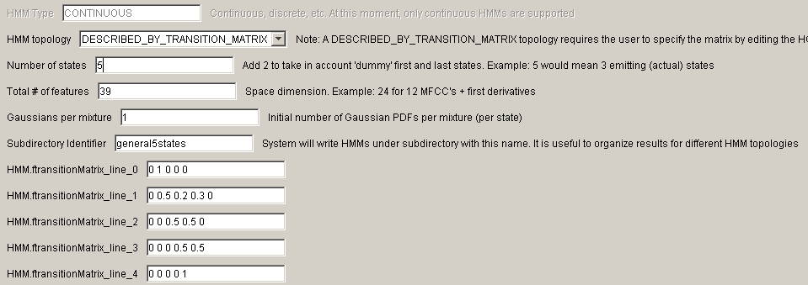
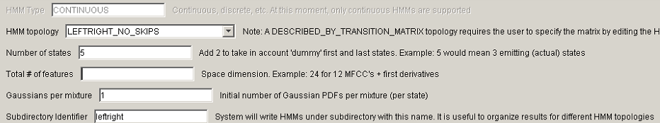
To describe generic transition matrix, edit HCN file “manually”:
NAME HMM.ftransitionMatrix_line_0 TYPE String VALUE 0 1 0 0 0
NAME HMM.ftransitionMatrix_line_1 TYPE String VALUE 0 0.5 0.2 0.3 0
NAME HMM.ftransitionMatrix_line_2 TYPE String VALUE 0 0 0.5 0.5 0
NAME HMM.ftransitionMatrix_line_3 TYPE String VALUE 0 0 0 0.5 0.5
NAME HMM.ftransitionMatrix_line_4 TYPE String VALUE 0 0 0 0 1

Slide 15
HMM Training
Segmental K-means (Viterbi)
Baum-Welch (Expectation-Maximization)
Embedded Baum-Welch

Slide 16
Spock - advanced topics
- Path organization
- Getting a summary of results
- Using the confusion matrix GUI
- Interface with Matlab
External (“alien”) front end reading feature files
- Interface with HTK
- Installation: download Sun’s Java 1.3. Put rasta and lsf in PATH
- Reporting errors and bugs
Obs: running on Unix or DOS prompt:
java -jar spock.jar

Slide 17
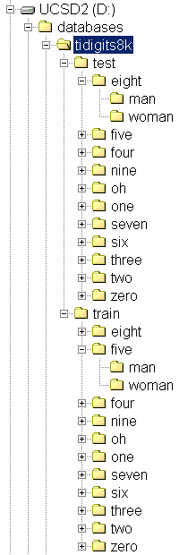
Input path structure
Testing sequence input root directory. Spock assumes “test” and “train” are the directory names and both are below the same root directory (tidigits8k in this case)
Training sequence input root directory. All subdirectories below this root will be considered a “label”. One HMM is created for each label and all HMMs are packed in one hmms.zip file, which can be opened with Winzip, unzip, etc.
“Label” directories
Spock will recursively search all subdirectories below a “label” X directory and all files with extension WAV will be considered examples of X

Slide 18
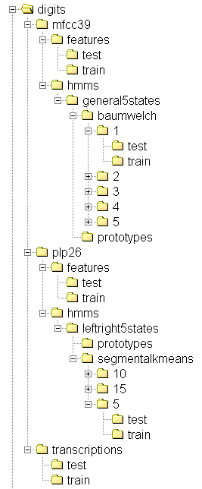
Output path structure
database
tableForScoring.TBL (used for organizing confusion matrix labels)
feature identifier
# of Gaussians per mixture
FEA files with features
hmms.zip (file with models) and HMMReestimation.log (training information)
HMM topology
HMM training algorithm
Results: CMF confusion matrix, DTL lattice files (one with errors, other with matches) and summary. In “train” are stored the results obtained with data used for training models and in “test” for testing sequence
Text files that list waveform files location

Slide 19
Getting a summary of results

Slide 20
Interface with Matlab
a) Read Spock feature files to Matlab:
readSpockFiles.m
readFEAHeader.m and readFEAEntry.m
b) Use Spock with an external (“alien”) front end:
alienFrontEnd.m
cepstrum.m and getFilesRecursion.m

Slide 21
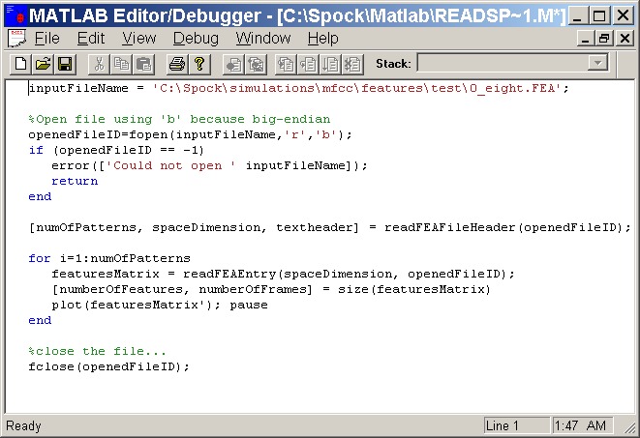

Slide 22
One “pattern” with 38 frames and 39 MFCC’s

Slide 23
One “pattern” with 70 frames and 39 MFCC’s

Slide 24
Using Spock with alien front end
1) Generate big-endian float files using Matlab, C, etc.
2) Convert “alien” files to FEA Spock files

Slide 25
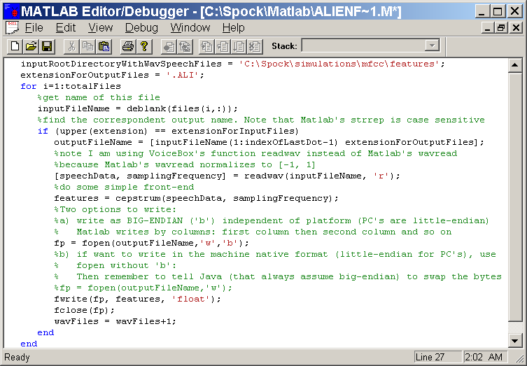

Slide 26
Then convert “alien” files generated by Matlab, C, etc. to FEA Spock files

Slide 27
Interface with HTK
The HMM’s are stored as binary files inside hmms.zip to save space
Save in text format as HTK
~o
<STREAMINFO> 1 39
<VECSIZE> 39 <NULLD> <MFCC_E_D_A>
~h "eight"
<BEGINHMM>
<NUMSTATES> 5
<STATE> 2
<MEAN> 39
-8.260213E000 -1.219884E000 4.099937E-002 -1.357703E001 1.035794E000 -8.084660E-001 6.239220E-002 -<VARIANCE> 39
1.161130E001 2.512689E001 1.539824E001 9.489104E001 2.337675E001 2.114777E001 2.434778E001 1.000721E001 <GCONST> 85.78961181640625
<STATE> 3
<MEAN> 39
-7.041616E000 5.890625E000 1.046831E-001 -2.374981E001 -2.961363E000 -6.014548E000 -6.496438E000
...

Slide 28
Spock installation
1) Download Java 1.3 JRE (5 MB) at java.sun.com. The 30 MB JDK is for people developing software in Java
2) Put java.exe in your PATH
3) Test using: java -version (must be >= 1.3)
4) Download Spock.zip, using to c:\Spock (or /Spock on Unix if possible) and copy spock.jar to desktop
5) Put lsf (.exe) and rasta (.exe) in your PATH. Unix users need to compile them. Unix version of RASTA can be downloaded at http://www.icsi.berkeley.edu/real/rasta.html

Slide 29
Reporting bugs and errors
Run from Unix or DOS prompt using:
java -jar spock.jar
Send the error trace to ece252b@hotmail.com:
ERROR: Can convert ALIEN files only if front end type is ALIEN. Failed because this front end type is MFCC
Exception occurred during event dispatching:
at edu.ucsd.asr.End.throwError(End.java:32)
at edu.ucsd.asr.ConvertALIENFrontEndToSOPFiles.<init>(ConvertALIENFrontEndToSOPFiles.java:25)
at edu.ucsd.gui.SpockFrame.importAlienFrontEndFilesButton_actionPerformed(SpockFrame.java:1445)
at edu.ucsd.gui.SpockFrame$10.actionPerformed(SpockFrame.java:411)
at javax.swing.AbstractButton.fireActionPerformed(AbstractButton.java:1450)

Slide 30
Connected words and large vocabulary systems

Slide 31
Why HTK ?
Results published by DARPA for the Broadcast News task in its 1998 workshop

Slide 32
Definitions
monophones (or phones or allophones): closely related to phonemes.
Problem 1: coarticulation, neighbors (context left and right) influence sound.
triphones: central phone with 2 neighbors. Two ways of defining triphones: word-internal (simpler) and cross-word (better results).
Problem 2: data does not suffice to train so many triphones. Solution: tying (sharing, clustering) HMM parameters. Problem 3: many cross-word triphones are not present in training data (phone ng, for example).
Example of tying techniques: data-driven and tree-clustering (can be used to synthesize "unseen" triphones).
Classification vs. recognition: classification assumes speech was segmented beforehand. TIMIT is a labeled database that allow us to do classification. Recognition is usually done for a whole sentence, without assuming the phone boundaries are known. For evaluation, the recognized sequence of phonemes is aligned with the correct one according to software distributed by NIST. Then, the number of insertions (I) , deletions (D) and substitutions (S) are counted. Below, N is the number of labels in reference transcriptions.
In search, parameters as grammar scale control the rate I / D. Example:
%Corr=60.46, Acc=49.14 [H=104868, D=14076, S=54506, I=19628, N=173450], where N = H + D + S.

Slide 33
Training sub-word models
Tying (sharing)
Short pause tee-model which has a direct transition from entry to exit node (two non-emitting states). This sp model has its emitting state tied to the center state of the silence model to avoid "competition" between the two silence models.

Slide 34
Results from HTK documentation for RM task
Flat start with 49 models, 39 parameters, 1 stream, diagonal covariances.
Plain monophones
1- ci_1G: 4 iterations of embedded training
2- ci_2G: mixture splitting, choose components with largest weight and perturb the mean. 4 embedded
3- ci_3G idem
4- ci_4G idem
Tied (semi-continuous) monophones
5- ci_ti128G:
a) set of 128 Gaussians are pooled by choosing those with highest weights. If the original number is smaller, use splitting
b) models are rebuilt to share the Gaussians
c) models change to TIEDHS
d) for testing: grammar scale set to 2.0 rather than 7.0 and pruning beam width from 200.0 to 100.0
Discrete monophones
6- ci_disc:
Word-internal triphones
7- cdwi_1G:
Tied word-internal triphones
8- cdwi_ti4s: from 1 to 4 streams - 128, 128, 128 and 32 Gaussians
9- cdwi_ti4s_smo: smooth using deleted interpolation
State-clustered word-internal triphones (share models of step 4)
Minimum number of state occupation = 100
[10 : 15]- cdwi_shXG, X=1,...,6 - word-internal models, 4 embedded after splitting mixtures
Tree-clustered cross-word triphones
16- cdcw_sh1G
17- cdcw_sh6G - cross-word models, 4 embedded training after splitting mixtures
Example of adaptation (1 speaker)
before: 89.04
after: 94.25

Slide 36
Conclusions
➔ 8AM is too early for a class
➔ Spock is a useful guy, at least in Star Trek
➔ Brazilians speaking English is a problem for ASR

